Slide 1
Features II: Detecting Interest Points and Matching
D E P A R T M E N T O F C O M P U T E R S C I E N C E U N I V E R S I T Y O F C O P E N H A G E N
Kim Steenstrup Pedersen
Notes:
Forelæsning: 32 (2013)
26 (2014)

Slide 2
Plan for today and next couple of lectures
We consider the problem of matching two or more images
Today we wrap up the problem of detecting good locations to match.
Then we switch our attention to how to perform the actual matching.

Slide 3
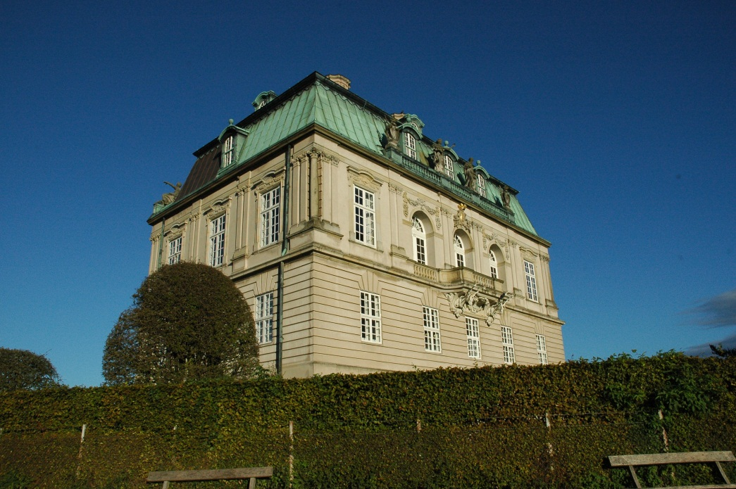
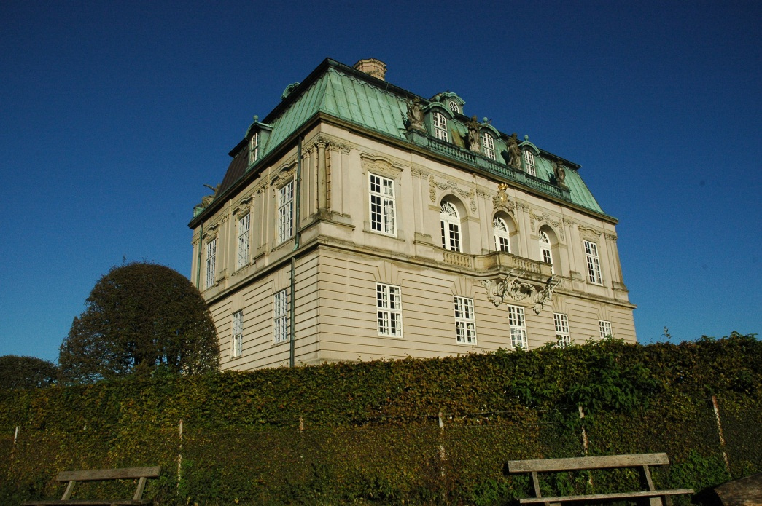
Fundamental Question: Where did the underlying feature go?
?
Notes:
Two different views of the same building

Slide 4
Regular grid vs random points vs salient points
Notes:
We are for now focusing on the approach of detecting salient points

Slide 5
Recall: Linear scale space
The scale space of I is a 1-parameter family
Scale is given by and is an important parameter in CV algorithms
As the scale increases details in the image disappear and we focus on the large scale structures that are left.
Notes:
At scale sigma=0 we have the original image

Slide 6
Recall: Detecting blobs by Laplacian of Gaussian filter
Finding extrema in 2D:
Find points that are simultaneous extrema in the x and y direction.
We can solve this in one go by looking for extrema of the Laplacian of Gaussian filter
Bright blob: Dark blob:
Discrete implementation: Extrema search in 2D
Bright blob: than all neighbor pixels
Dark blob: than all neighbor pixels
4-neighbors or 8-neighbors
Keep only blobs where threshold value
Notes:
In principal we should look for points of zero gradient – these are all candidate points
The Laplacian (2nd order derivatives) tell us if it is a local maxima or minima.
By looking for local extrema of the Laplacian we are reducing further the amount of detected points.
Next year: Stress that the + in the Laplacian is pixelwise – matrix addition (they are not confident with matrices).

Slide 7
Interest point detectors: Multi-scale Laplacian blob detector
Finding extrema in scale-space:
Due to blurring, the Laplacian response decay over scale – solution: Use scale normalization.
Scale normalized Laplacian:
Bright blob: Dark blob:
Discrete implementation: Extrema search in 3D
Bright blob: than all neighbor pixels
Dark blob: than all neighbor pixels
6-neighbors or 26-neighbors
Keep only blobs where threshold value
Notes:
The max. response of Gaussian derivative filters decay with scale because of blurring / averaging. We can compensate for this by scale normalization.
Blurring lowers the contrast of the image (squeezing), by multiplying by the scale level we increases the contrast appropriately (stretching).
Next year: Try to improve the arguments for scale normalization.

Slide 8
Interest point detectors: Detecting Laplacian blobs (fixed scale)
Notes:
Gray scale intensities to make it easier to see if a blob is bright or dark
Yellow: Dark blobs
Red: Bright blobs
Scale = 4

Slide 9
Interest point detectors: Detecting Laplacian blobs (multi-scale)
Notes:
Circle radius is equal to detection scale

Slide 10
The gradient vector field
Where are the intensity corners located?
Notes:
We look for locations with change in intensity in multiple directions.
Lets switch to gray scale and look at the gradients.

Slide 11
Interest point detectors: Detecting corners with Harris corner detector
Harris corners are defined as points of local maxima of the Harris corner measure:
Where
It encode gradient information under the window G.
R obtain maxima at intensity corners, but also for other structures.
This version is referred to as the improved or fixed scale Harris corner detector.
Notes:
Corners formed by iso-intensity curves. Look for regions of change in multiple directions.
Alpha is a constant that needs to be fixed, alpha=0.06
A is related to the autocorrelation function and is also sometimes referred to as the structure tensor.
Gaussian window. A matrix per pixel in the image
In terms of eigenvalues: R=e1*e2 – alpha * (e1 + e2)^2
The size of the response R tell us how much a corner this region resembles. Select only local maxima of R to get good corner candidates.
Next year: Give an intuitive explanation of why Harris detects corners.

Slide 12
The gradient vector field

Slide 13
Interest point detectors: Detecting Harris corners (fixed scale)
Find max. of

Slide 14
Interest point detectors: Detecting Harris corners (multi-scale)
Find max. of
Notes:
Again search for maxima in scale-space (in 3D)

Slide 15
So which detectors are the best?
Based on joint work with Anders Dahl and Henrik Aanæs from DTU
Interesting Interest Points.
International Journal of Computer Vision, 97:18 – 35, 2012
Notes:
To compare interest point detectors we need a large controlled data set with 3D ground truth.
My DTU colleagues collected data in the following way.

Slide 16
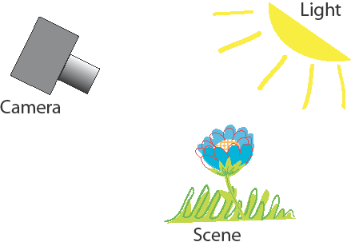
The Image Formation Process: We need controlled ground truth for comparison
We Want to Control it All in a Systematic Way
Notes:
Light, scene and camera position and intrinsics are important factors.

Slide 17
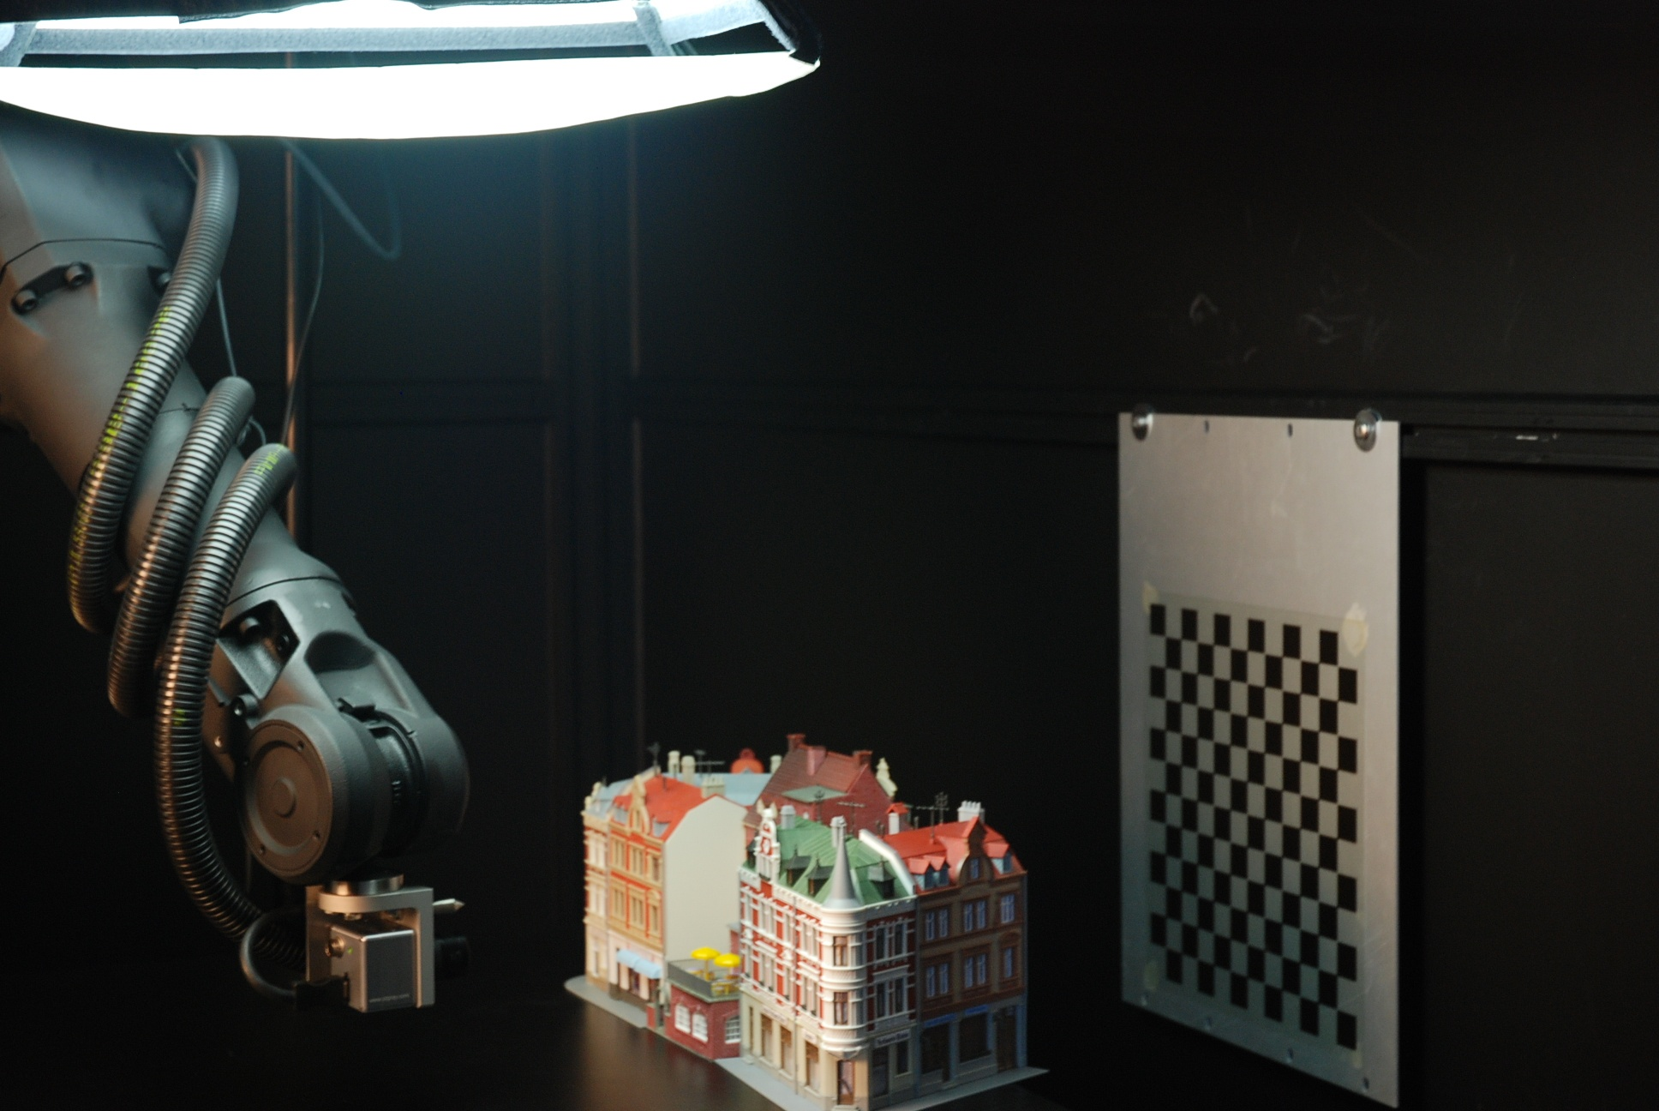
Method: Play Around with Robots ☺

Slide 18
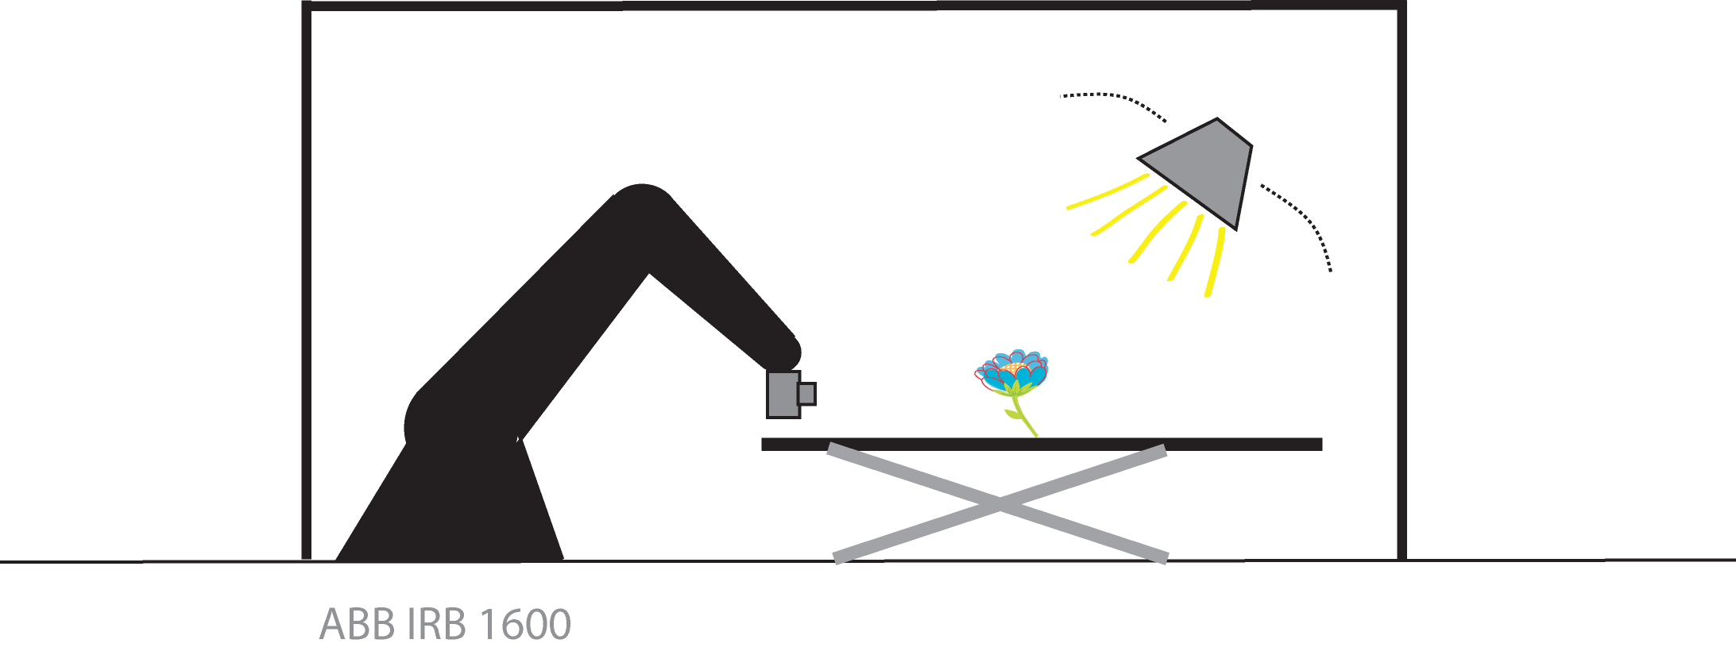
Method: A Configurable Computer Vision Workbench
Controlled/Measured:
Scene
Geometry
Camera position
Camera Optics
Light

Slide 19
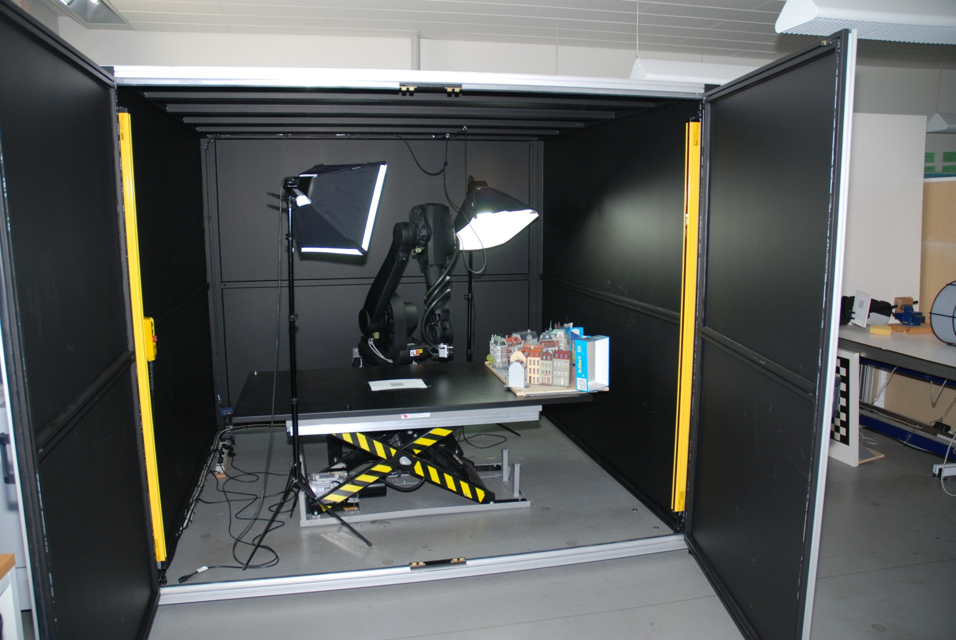
Method: A Configurable Computer Vision Workbench
Notes:
Actually the lamps are not used, instead an array of LED spot lights are used

Slide 20
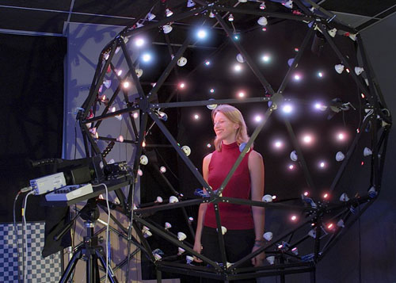
Light
“A Lighting Reproduction Approach to Live-Action Compositing “, Debevec et al.
Notes:
Inspired by the Light stage idea of Debevec et al. (additive model)

Slide 21

Data Recording – Fast forward
Notes:
Structured light scanning for 3D ground truth.
Skip the last part with the skull 360 degrees

Slide 22
Feature Matching Evaluation
What we used it for
Notes:
To compare interest point detectors we need a large controlled data set with 3D ground truth.
My DTU colleagues collected data in the following way.

Slide 23
Data set: 60 Scenes, 119 Positions
Notes:
Arc 1: 0.5 m, +/- 40 degrees span
Arc 2: 0.65 m, +/- 25 degrees span
Arc 3: 0.8 m, +/- 20 degrees span

Slide 24
Sample Scenes – 60 in All
Notes:
A lot of variation in scene types and planar as well as non-planar.
From matte surfaces such as cloth and twigs to specular surfaces such as beer cans

Slide 25
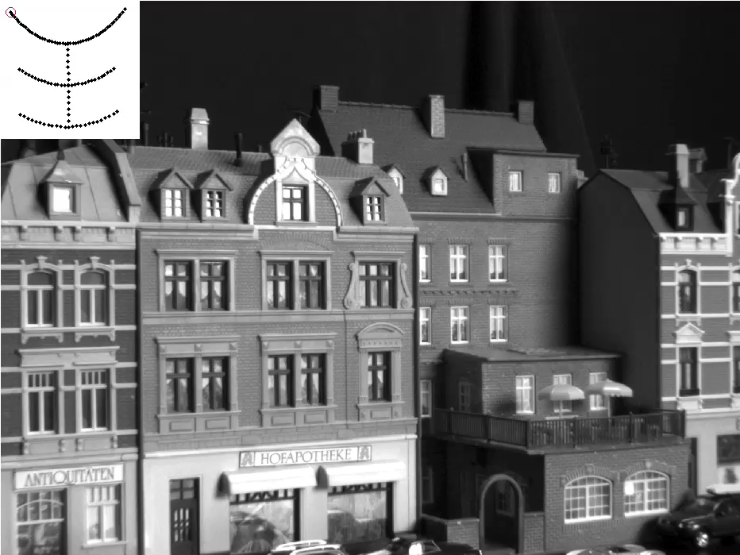
An Example

Slide 26
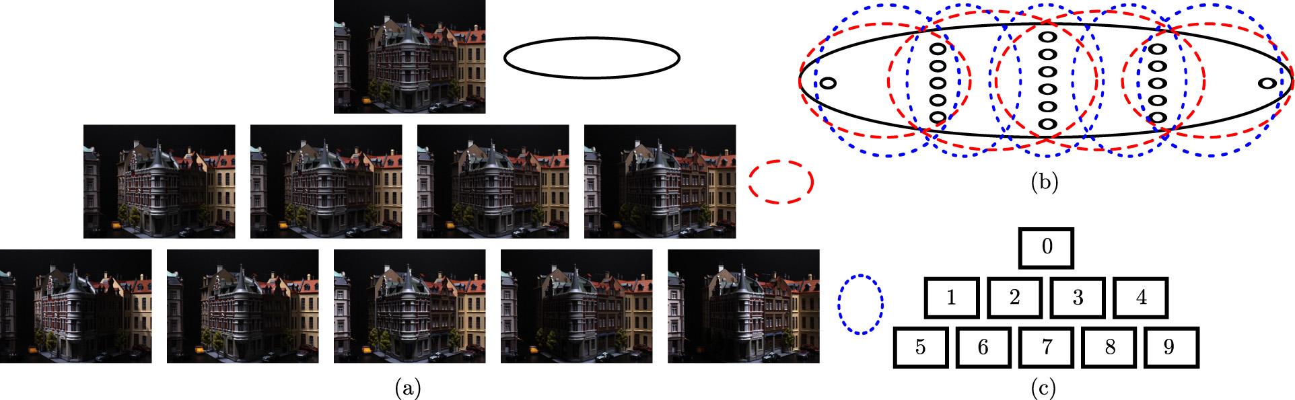
Light
Notes:
We can vary the direction of the light synthetically from each separate LED image (image with one LED light source switched on):
Top: diffuse directionless lighting
Going downwards more and more focused lighting giving cast shadows.

Slide 27
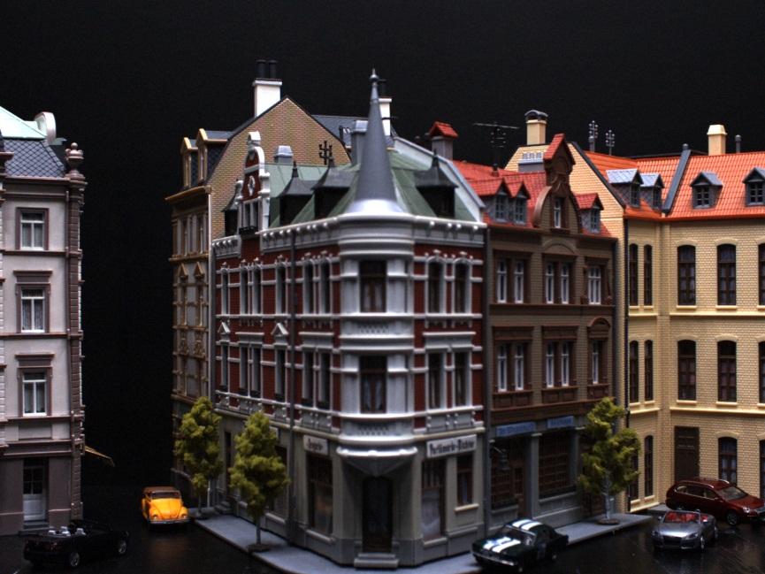
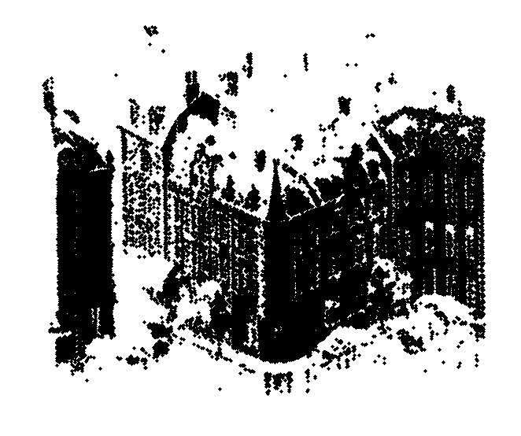
Ground ‘Truth’ Via Structured Light

Slide 28
Our Analysis: Investigate the recall rate of Interest Point Detectors
Detectors used:
Harris and Hessian Corner Detectors Mikolajczyk & Schmid 2004
Plain
Laplace
Affine
MSER Matas et al. 2004
Intensity & Edge Based Regions Tuytelaars & Van Gool 2009
Fast Corner detector Trajkovic & Hedley 1998
DoG Lowe 2004
Implementations downloaded of the net
Notes:
A potential match: If one or more points in the other image pass the 3 tests a match is counted for the point in the key frame.
Total Interest Points: Total number of interest points detected in the key frame.
Recall rate must be high

Slide 29
Evaluation Criteria: Determining the Correctness of a Match
Epipolar line
Epipolar plane
Baseline
Epipole
Notes:
Epipolar Geometry: Epipoles can be outside image plane.
Epipolar Line: A potential match in the other image must be within 2.5 pixels orthogonally on the epipolar line formed by the optical centers and the point in the key frame.
Surface geometry: The detected 3D points should lie close to the ground truth surface. Match consistent with the true geometry of the scene.
Absolute Scale: We want to see the same patch of 3D surface in both images, hence the detectors should localize interest point across scale

Slide 30
Effect of Position

Slide 31
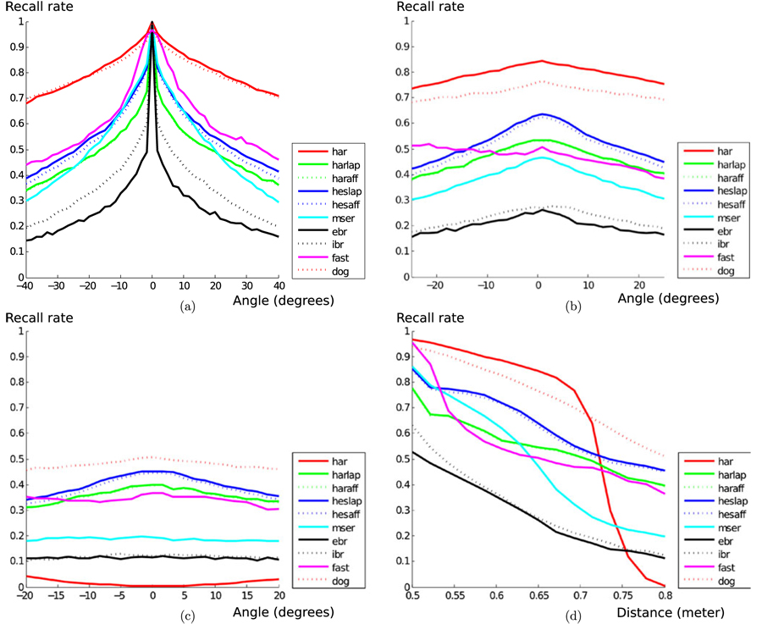
Effect of position
Notes:
Results averaged over all 60 scenes.
DoG and fixed scale Harris does well, except fixed scale Harris performs poorly over scale.
Multi-scale Harris actually perform quite well (/not included).

Slide 32
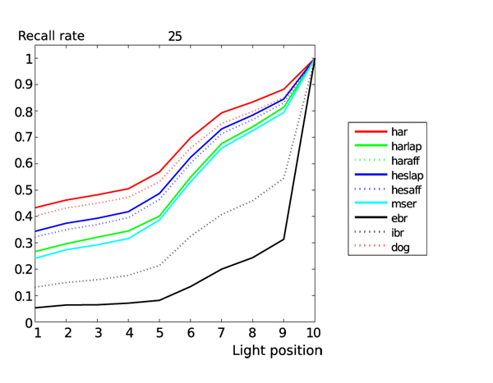
Effects of light
Notes:
Position 10 is diffuse lighting.
Change in lighting is difficult to handle for all.

Slide 33
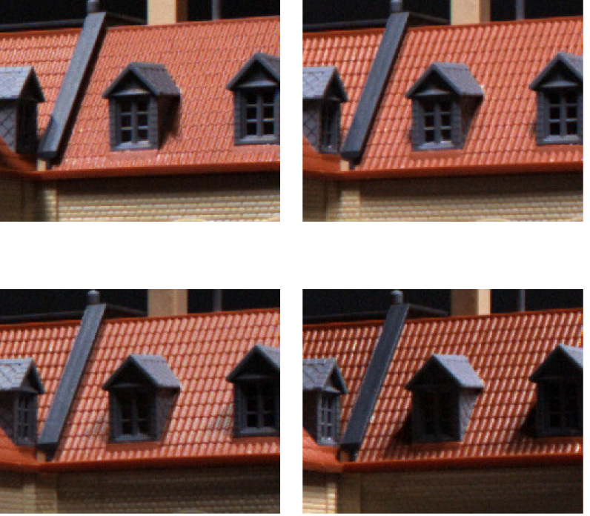
A challenge to handle changing light
Notes:
Not that strange – appearance changes a lot.

Slide 34
Outline of First Stage Findings
Performance drops with increasing view angle and distance to scene.
Light is more disruptive than position (angle & scale).
Best Performers are:
Harris Variants
DoG (SIFT Blobs)
MSER
Hessian Laplace Variants
Observations:
DoG (SIFT Blobs) is much better than Hessian Laplace.
Plain Harris is better than extensions, when scale does not change.
FAST is very erratic wrt. to number of features.

Slide 35
How can we perform the actual matching
without ground truth?
Notes:
In the experiment we used 3D ground truth to validate matches of interest points, but …

Slide 36
Matching Strategy Illustrated
Notes:
Find potential matches – in principal we can have several candidates

Slide 37
Salient Feature Matching Strategy
For a pair of images:
Extract salient points, via detectors e.g. Harris corners, DoG (blobs), MSER
Compute Feature descriptors, eg. Raw patch (correlation), SIFT, DAISY
Match features by pairing similar descriptors
Aggregate solution to multiple images, if needed.

Slide 38
Detecting points by template matching
Template
?
How to construct a generic corner template?
Bad idea – won’t work!
A bad idea for point detection, but what about description?
Notes:
Template must be robust to changes in view point, scale and illumination.

Slide 39
Matching patches
?
Notes:
Is patch F1 similar to patch F2?

Slide 40
Using raw pixel patches as descriptors
Represent a patch with the raw pixels – the patch is the descriptor.
Compare patches pixel by pixel, e.g. by (For simplicity lets assume gray scale intensities and the sums are over all pixels in the patches.) (Patches must be of equal size)
This is referred to as either distances or dissimilarity measures
Notes:
Not similarity measures because we want them to have small values for similar patches and large values for dissimilar patches.

Slide 41
Using raw pixel patches as descriptors
We need to compensate for changes in illumination conditions, because …
Contrast change a and change in brightness level c (affine model):
We want F’ and F to have zero distance, but
Invariance wrt. affine intensity changes by normalization:
Notes:
The affine model of intensity distortions is not a completely realistic model, but is a good approximation.
Normalization: So how do we pick a and c?

Slide 42
Matching patches: Normalized cross correlation
Compute mean intensity and standard deviation for each patch (sum over all n pixels in patches)
Measure distance with normalized cross correlation
Affine intensity invariance:
Notes:
Subtract mean to remove additive constant and divide by variance to remove muliplicative contrast change factor. Standard deviation is a good measure of the constrast in a patch – It measures the spread of intensities in the patch.
Can also be interpreted as the angle (dot product) between the two patch vectors.

Slide 43
Open problems
What patch size should we use?
Use the detection scale and resample so both patches have equal size in pixels
Is this approach robust to scale changes in the scene?
Yes, if we do the resampling (see above)
Is this approach robust to rotation and translation in the scene?
No, this will lead to large dissimilarities
Is it robust to perspective distortions?
No, this will lead to large dissimilarities

Slide 44
More on this at the next lecture

Slide 45
Summary
Multi-scale interest point detection
Blobs (DoG, Laplacian)
Corners (Harris corners)
Comparison of state of the art detection methods
Matching salient points
Using raw pixels and normalized cross correlation
Works sometimes, but not a robust solution

Slide 46
Literature
Reading material:
Aanæs-Dahl-Pedersen IJCV 2012
Harris-Stephen 1988
Additional material:
T. Lindeberg 1996 (Multi-scale detection)
T. Lindeberg. Feature detection with automatic scale selection. International Journal of Computer Vision 30(2): 79 – 116, 1998.
Notes:
Next year: The Lindeberg paper I think is overkill for them – convert it to additional material

Slide 47
Any questions about the assignment?

Slide 49
Interest point detectors: Detecting blobs by Difference of Gaussians (DoG)
Difference of Gaussians (DoG) is an approximation to the Laplacian of Gaussian filter
Either subtract Gaussian filters prior to filtering or subtract filtered images.
As before look for extrema in
In a multi-scale setting compute the scale space images with factor k increase in scale and search for extrema in scale space. Can be combined with a Gaussian pyramid for increased processing speed.
Notes:
k is a scaling factor

Slide 50
Multi-scale versus multi-resolution: The Gaussian pyramid
Notes:
This is simply an implementation of scale space taking advantage of the reduction in detail
Next year: Consider adding a bit more details here: E.g. subsample by taking every second pixels after Gaussian blurring.

